Slide 1
Pakistan’s InfoSecurity Posture & Challenges
Lets have a look at the typical IT & Information Security challenges

Slide 2
Pakistan’s InfoSecurity Posture & Challenges
IT
InfoSec
Compliance
Risk
Audit
CONTENTION
CONTENTION
CONTENTION
CONTENTION

Slide 3
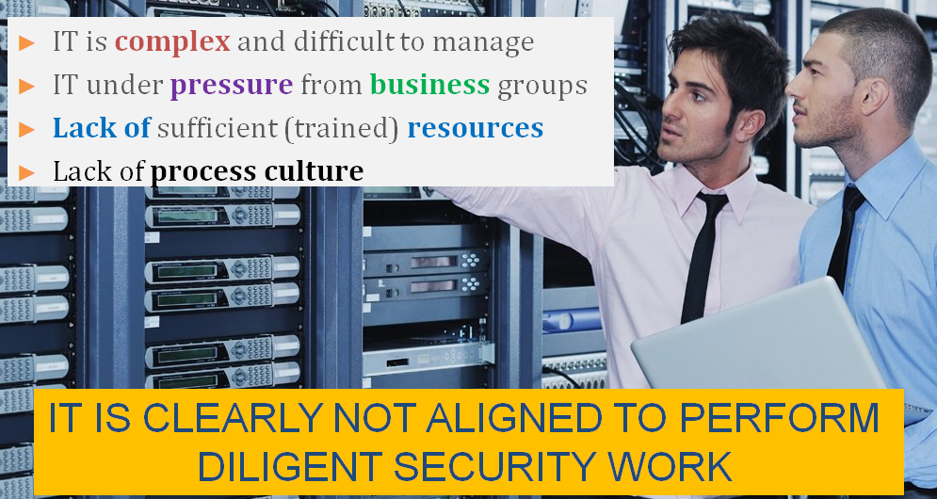
Pakistan’s InfoSecurity Posture & Challenges
IT CHALLENGES SUMMARY

Slide 4
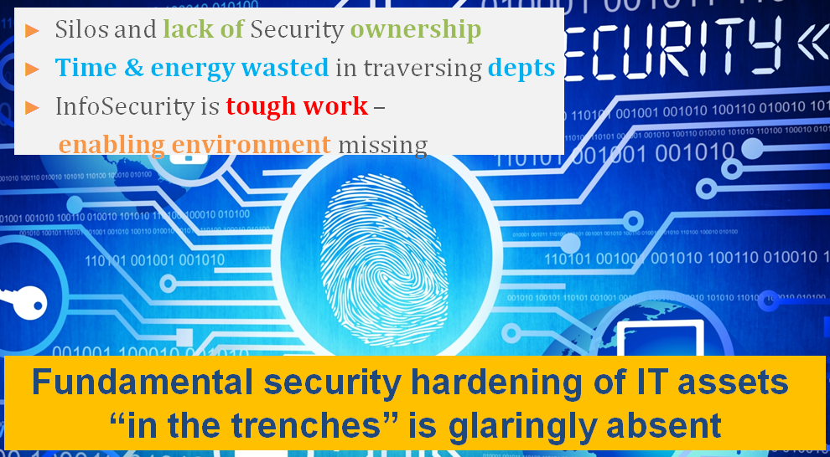
Pakistan’s InfoSecurity Posture & Challenges
INFORMATION SECURITY CHALLENGES

Slide 5
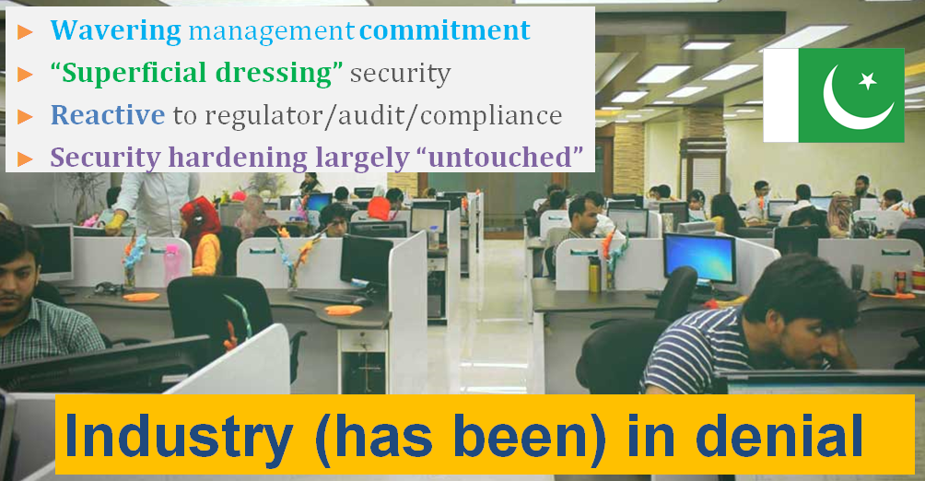
Pakistan’s InfoSecurity Posture & Challenges
PAKISTAN INDUSTRY CHARACTERISTICS

Slide 6

Pakistan’s InfoSecurity Posture & Challenges
PAKISTAN INDUSTRY CHARACTERISTICS
Security Harden ?
Manage Security ?

Slide 7
Pakistan’s InfoSecurity Posture & Challenges
Pakistan is now almost one entire technology generation behind in Information Security
IT progressed during the last 10-12 years but InfoSec was ignored
Information Security Transformation Model is the only way to catch up
END

